Slide 1
High Performing
Governance
Bridging the Gap between Political Acceptability and Administrative Sustainability

Slide 2
Outline
A gap exists and is growing between what is politically acceptable and administratively sustainable
Bridging the gap requires political astuteness
Understanding that politics involves choices among conflicting values – no value profile is best
Politics and administration involve more than different behaviors; they are different ways of thinking
Identify bridge building, translating and aligning roles for chief administrative officers and upper level staff (electeds value added)

Slide 3
Governing Body
Have you considered whether the length and width of the line might make a difference in the relationship between the two arenas?
City
Manager
Staff
Notes:
What does this basic diagram mean to you?
If you were using it to explain council-manager government, what would you say?
Note that managing the gap/working the bridge is an accepted cm responsibility.

Slide 4
Governing Body
CM
Staff

Slide 5
Governing Body
Political Acceptability
Community and third parties
CM
Community and third parties
Administrative Sustainability
Staff

Slide 6
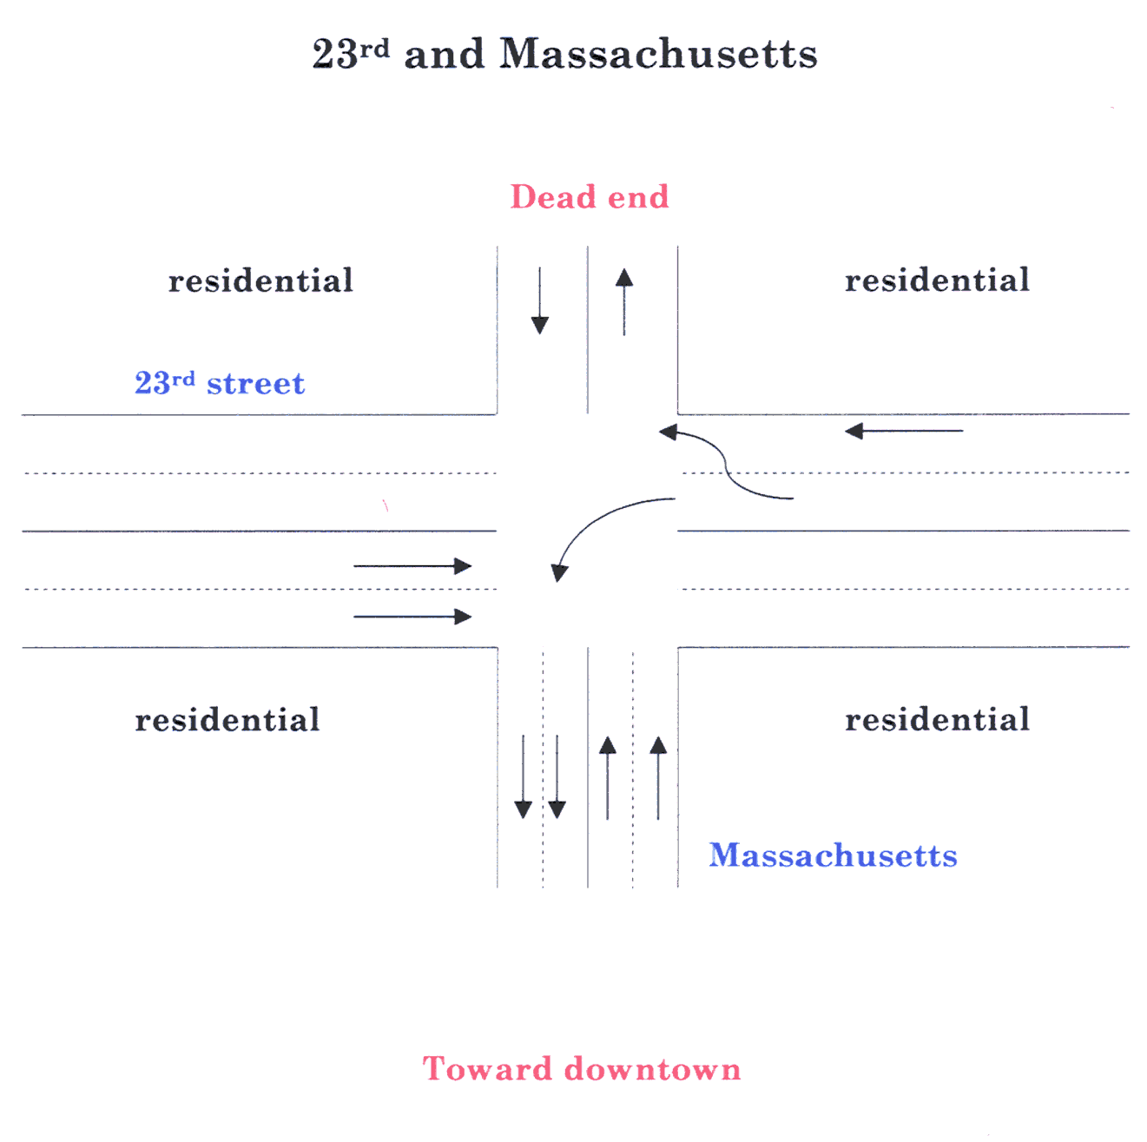

Slide 7
Values
RESPONSIVENESS =
Representation/Participation +
Efficiency/Professionalism +
Social Equity +
Individual Rights

Slide 8
Characteristics of
Politics and Administration
Political Acceptability Administrative Sustainability
Characteristics | Politics |  | Administration
Activity | Game/allocation of values |  | Problem Solving
Players | Representatives/trustees |  | Experts-trustees
Conversation | “What do you hear?” Passion Dreams Stories | CAO and Senior Staff in the GAP Electeds* | “What do you know?” Data Plans Reports
Pieces | Intangible: Interests and symbols |  | Tangible: Information; money, people, equipment
Currency | Power (stories), loyalty, trust |  | Knowledge (deeds)
Dynamics | Constructive conflict, compromise, change |  | Predictability, cooperation, continuity

Slide 9
Facilitating Roles
Translate the logic of politics and administration
Bridge the gap between what is politically acceptable and administratively sustainable
Align
Staff priorities with governing body goals
Governing body and staff expectations

Slide 10
Summary
Bridging the gap is essential
Cups matter
Good politics is about values, not right answers – stories matter (convey values)
Do not ignore any value over time
Democratic process is “messy”
Politics/administration = ways of thinking
Role of translator/bridge builder is critical
Aligning governing body/staff expectations is crucial
Difference between “representative” and “trustee"

Slide 11
John Nalbandian
University of Kansas
Nalband@ku.edu

