Slide 1


Governing in a Disruptive Environment
Charting a Course in a Stormy Sea
John Nalbandian
www.goodlocalgovernment.org
nalband@ku.edu
Notes:
Bob O’Neill and I were asked to write an opening chapter about professionalism in local government for a publication sponsored by the International city/County Management Association. Bob is former exec dir of ICMA and the NAPA as well as county manager in Fairfax County, VA where he oversaw the work of some 14,000 employees.
To prepare ourselves, we asked a few open ended questions of small groups of local government administrators who had attended icma exec development programs, and also a few others that we know and consider “thought leaders.”
We started by asking what contemporary forces were expected to influence the work of local government leaders. GO TO NEXT SLIDE

Slide 2
Disruptive Forces Affecting Local Government
National politics filtering down
Technology
Social issues
Widens the gap between:
Political acceptability
Operational sustainability
Network Leadership on Paths to Reconciliation
Networked problem-solving structures
Engagement processes in the community and in the organization
Develop bridge building roles and responsibilities
Increases policy capacity producing community resilience and a sense of community for all
Notes:
We identified the three in the first box in the chart. The chart outlines my presentation
Retired CM, Jim Keene, used the term “disruptive” forces, and we latched onto that label. He wrote that disruptive forces are inevitable; responding to them, which he called “reconciliation” is intentional. We will get to the paths of reconciliation in just a minute.
Review the elements in the chart
While reconciliation occurs with effective work responding to the leadership challenges, the third box is the key
Political acceptability=what can we agree to do?
Administrative sustainability=Can we do it, and can we do it over time.
Even more likely is the presence of operational needs, but does the political will exist to engage them.
The Council-Manager form of local government like you have in ???? was intentionally designed in part to create space between political and administration so that without fear of retribution admin staff could tell electeds “what they need to know” rather than “what they want to hear”
But while we seek appropriate separation, the fact of the matter is that nothing substantial can be done if the political and administrative work can not be effectively joined in what I call “bridging the gap.” The challenge we face today is that the disruptive forces are making it more difficult to bridge the gap challenging standard roles and responsibilities, structures, and processes. In other words, challenging not only how we go about our work but our capacity to do that work.
The box between the disruptive forces and the gap represents the potential impact that the disruptions can have on a community’s identity, and then the impact that has on widening the gap. I will share a few thoughts on change and identity in a few minutes.
Now, let’s take a look at what Jim Keene labels as paths to reconciliation. Remember, the argument is that disruptions are inevitable, responses to them—paths to reconciliation—are variable and take intention.

Slide 3
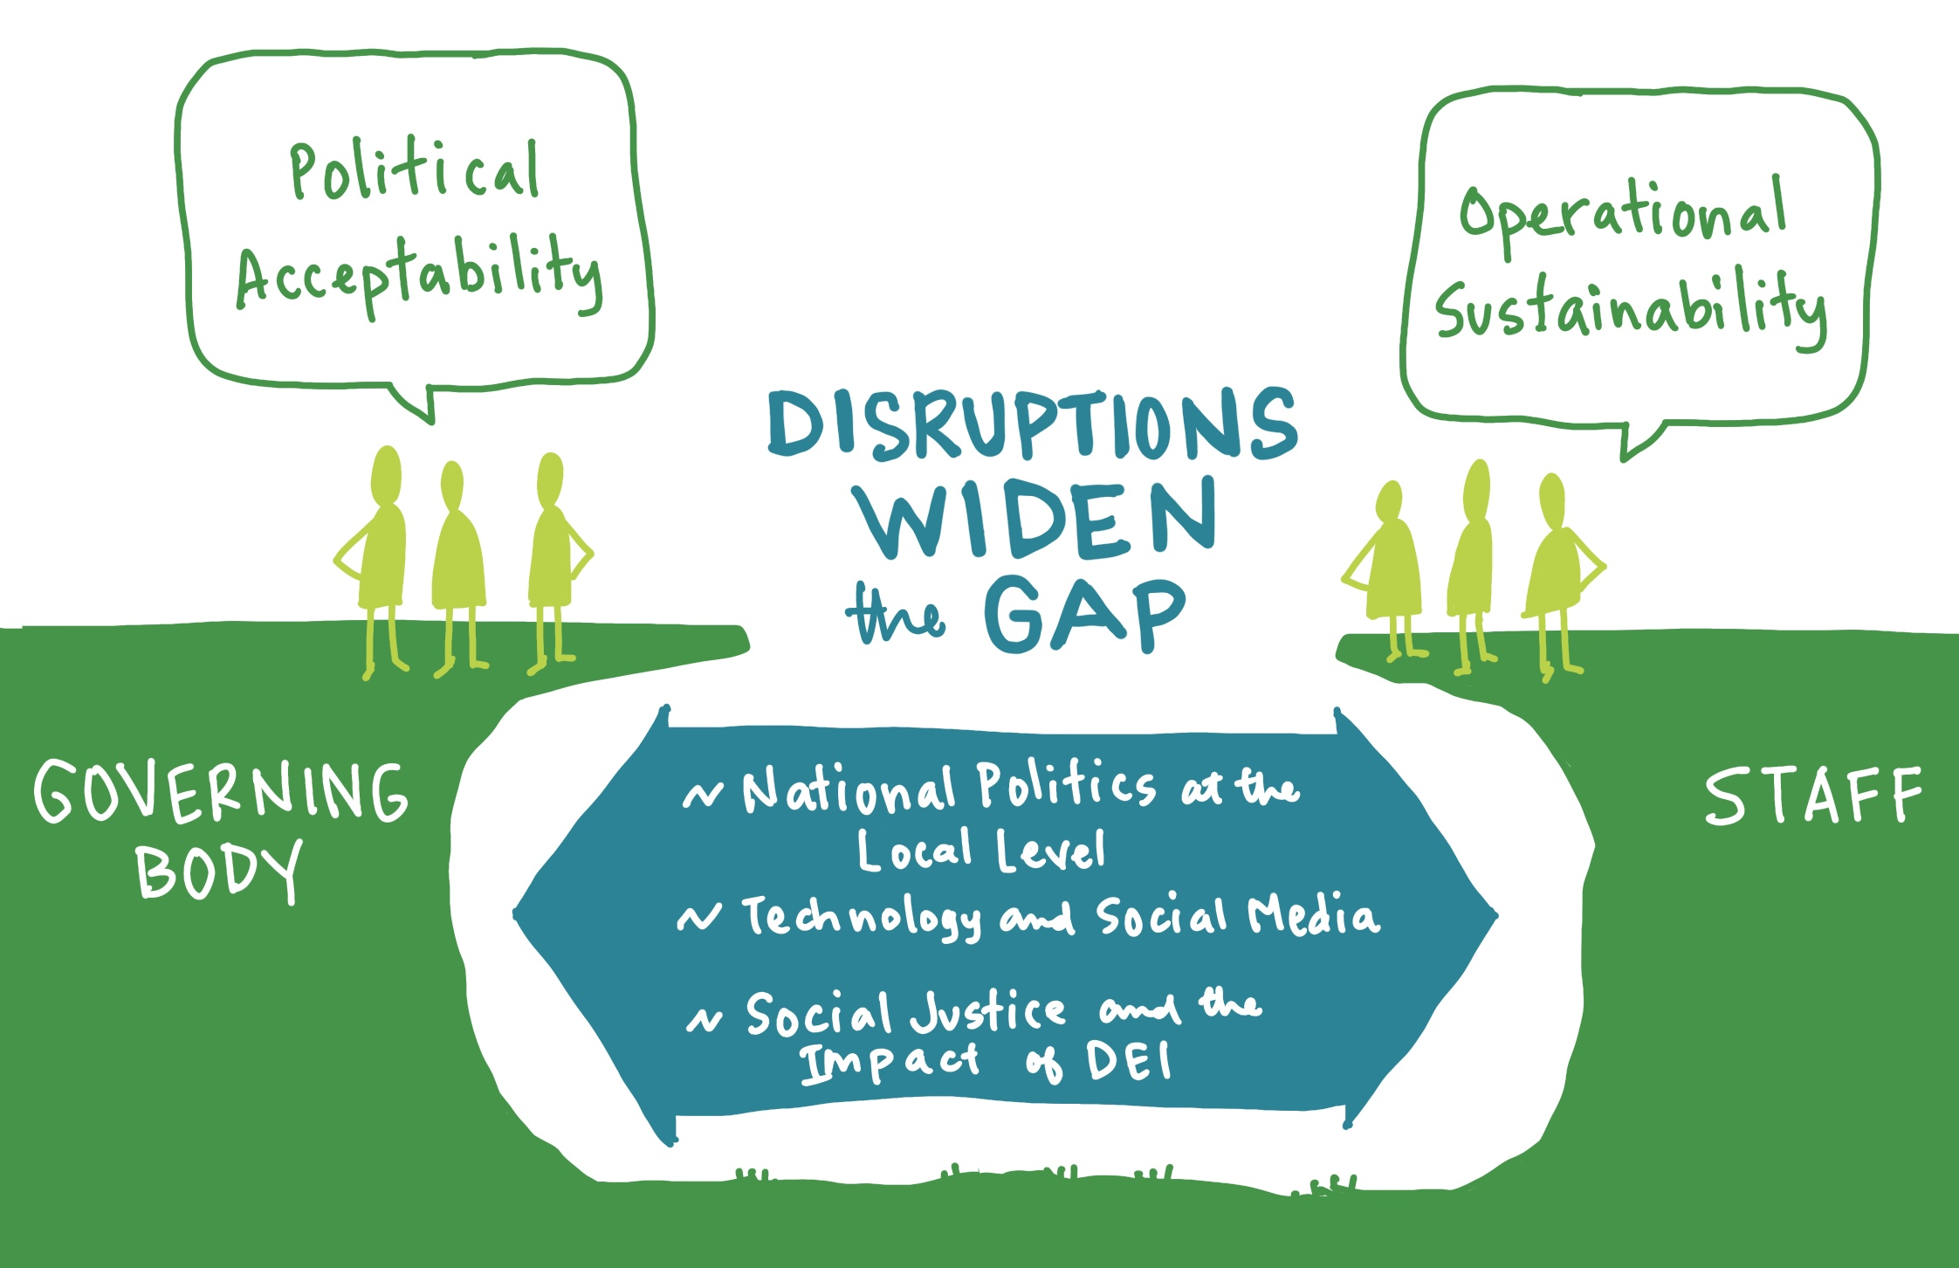
Notes:
The disruptions widen the Gap between political acceptability – what we want to do – and Operational Sustainability – what we are resourced to accomplish.

Slide 4
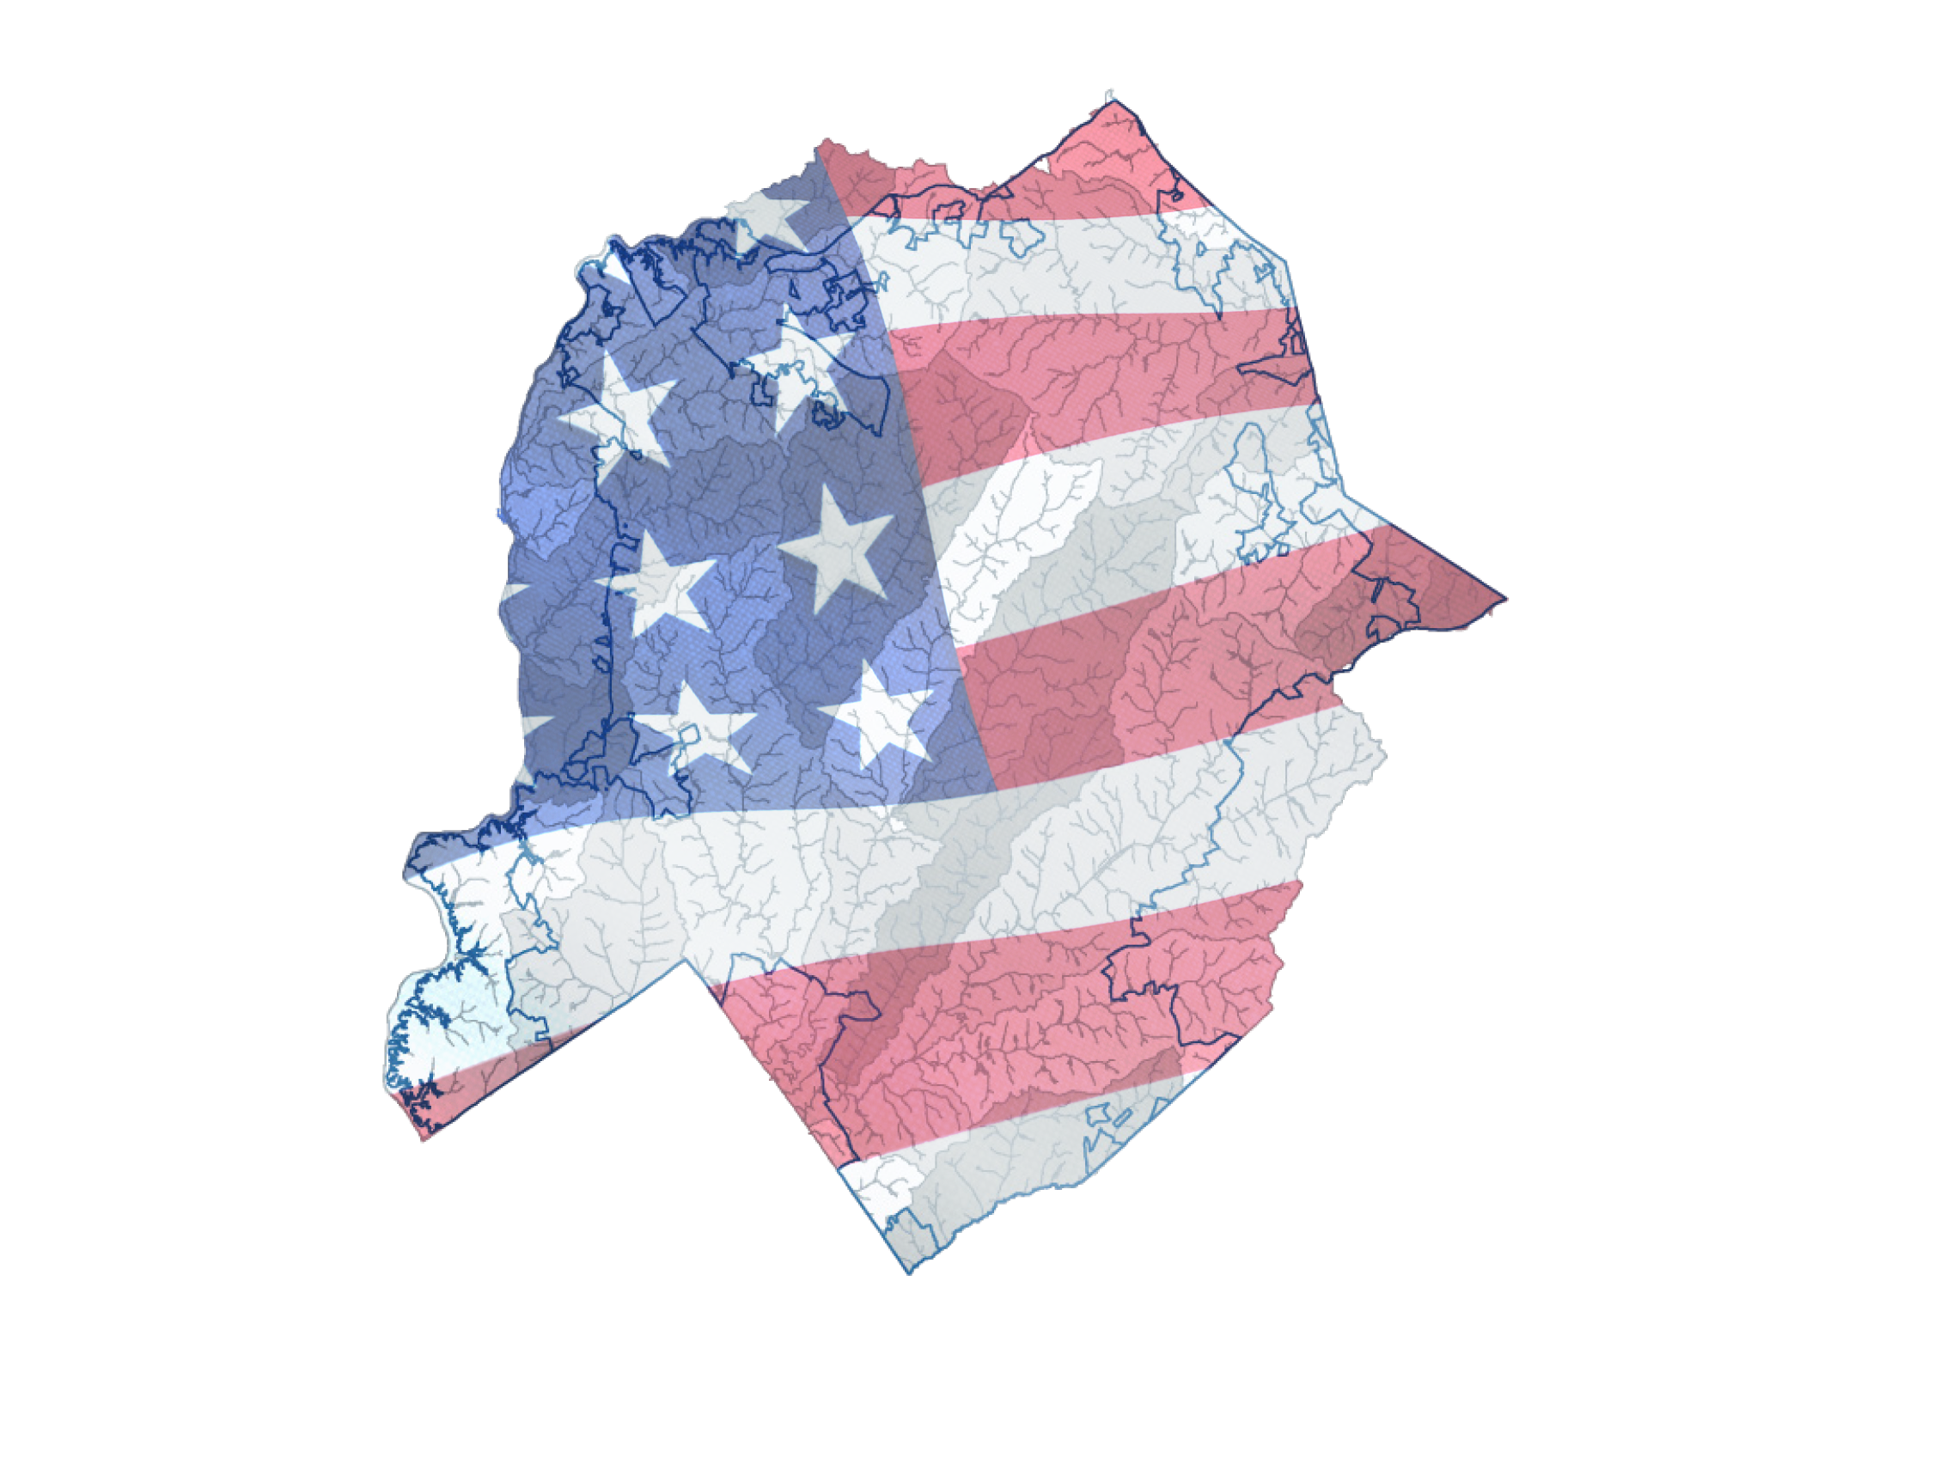
Driver 1
National Politics Filtering into Local Governance
“All politics is local” has become “all politics is national.”
“The deep division in national politics has crept its way into local governing bodies. We have seen local elections influenced by outside funding and individuals running for City Council who want to be legislators, not members of a governing body. The art of politics—cultivating consensus and legitimately debating an issue and being willing to be influenced by others—is quickly disappearing.”
Julia Novak, Former City Manager in the Northeast and current local government consultant

Slide 5
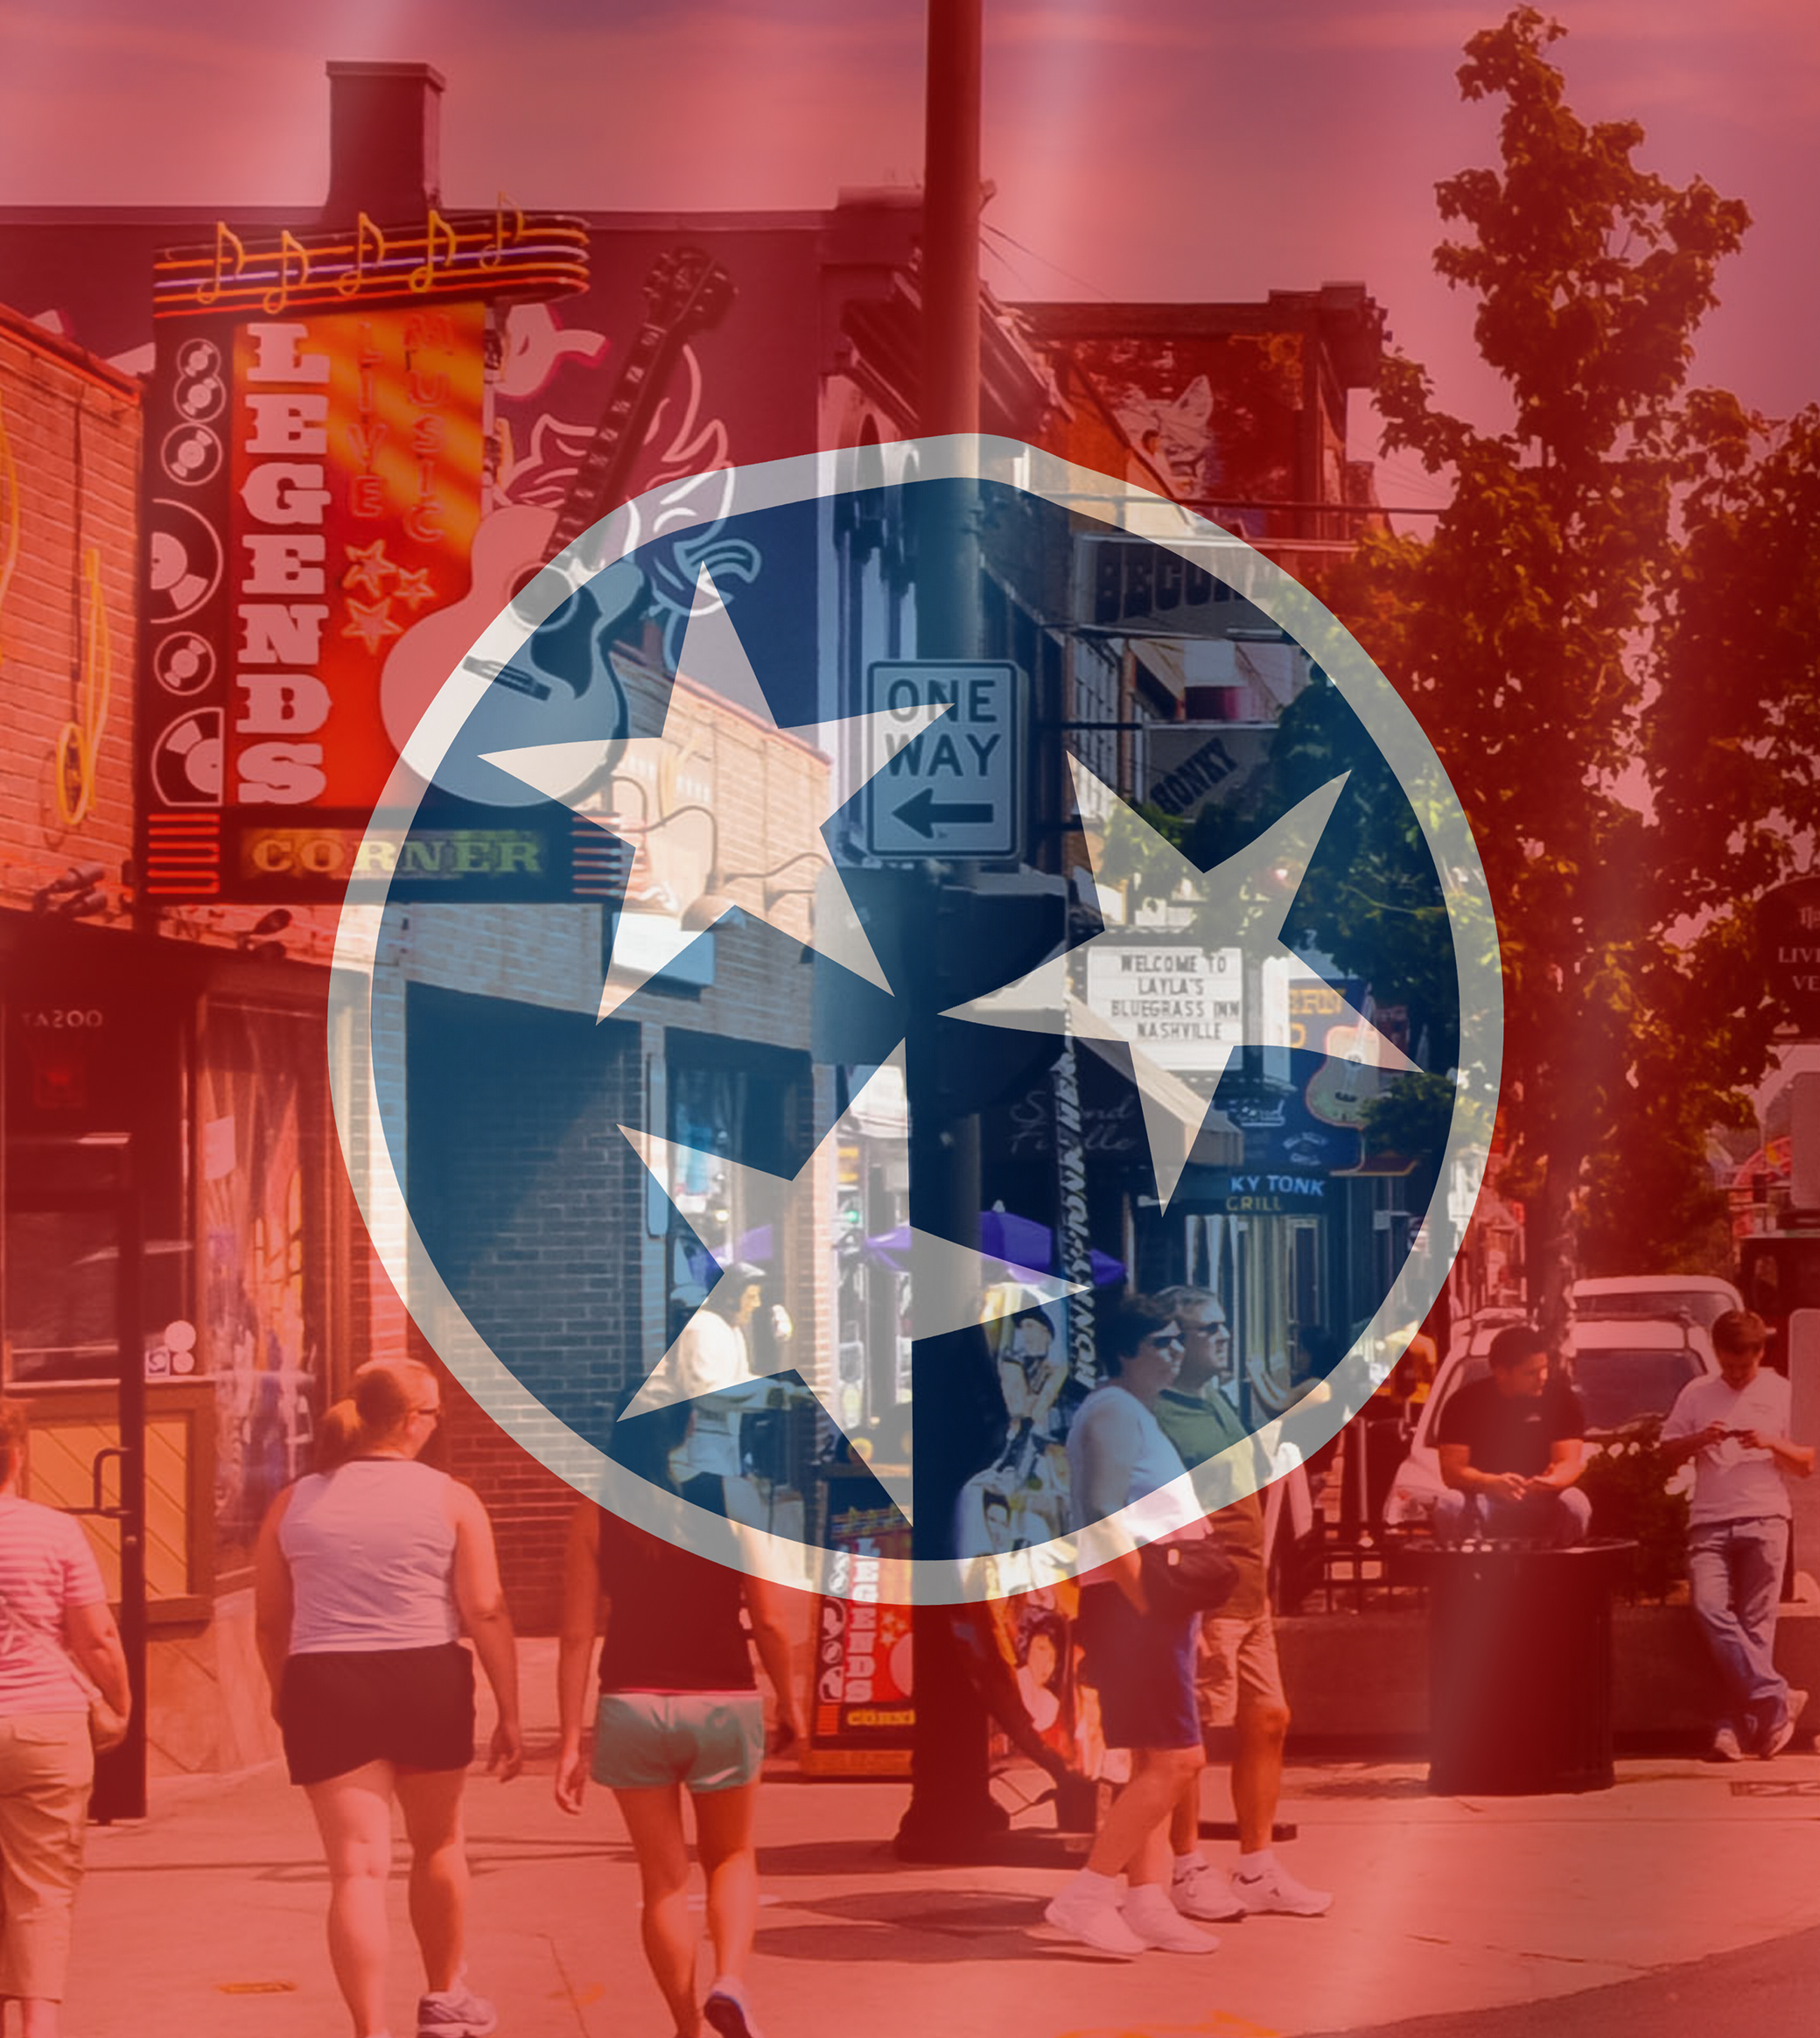
State-Local Relationships
“I believe we will see a continuation of state governments attempting to pre-empt more elements of local government services and policymaking. Politically, state government leaders (elected and appointed) can score points and gain power by exerting control over what local governments do and how they do it. I believe that state pre-emption will enter into more aspects of what we want to do and how do it at the local level.”
Eric Stuckey, CM, Franklin, TN

Slide 6

Driver 2
Technology and Social Media
“There are challenges for local government that are driven by economic variables and performance for service delivery but also by resident preferences for how they want to interact with their government for information, goods and services. Residents are consumers and governments are expected to provide more virtual services akin to the private sector. Government officials must understand key technology components in order to manage risk, budgets, and expectations for service delivery.”
Mark Israelson, CM, Plano, TX
Notes:
A council member at a recent workshop said that lack of investment in technology hinders this goal
Also, on the social media side of this driver, I am hearing more and more that technology provides so many avenues of access that may be utilized more by some elected officials than others—setting up possible points of contention within the governing body and confusion among residents about what constitutes accurate info.

Slide 7
Driver 2: Technology and Cyber Security
“One of the most serious challenges facing local leaders today is securing Internet-connected devices (which in this day and age means virtually everything in an office from our desk phones to our HVAC systems). Anyone from a disgruntled local hacker to a nation-state actor can hijack a community’s networks and take basic services offline for hours, days or weeks. This threat consumes financial resources that might otherwise be invested in advancing technology to improve public services as well as political capital that might otherwise allow for risk-taking in both technological and human innovations.”
Phil Smith-Hanes, County Administrator, Saline County, Kansas
Notes:
Very recently I was presenting this material to the Kansas managers, and Phil Smith-Hanes added this component.
Next slide

Slide 8

Driver 3
Social Issues
“We are having a racial reckoning in our society right now and it is driving a relook at our institutions; communities are coming to terms with the fact that our institutions are perpetuators of racist policies, practices, and behaviors, and because of that, there is a deepening distrust of our institutions and the people in them. Policing “best practices” are being questioned far and wide, and for good reason. Our black, indigenous and people of color communities don’t trust the Police; not just individual, racist police officers, but the actual institution of the Police. City departments perpetuate (knowingly and unknowingly) racist policies from purchasing and contracting to zoning and housing. Because technical experts (professional staff) are part of those institutions, they are viewed with skepticism.”
Sherilyn Lombos, CM, Tualatin, Oregon
Notes:
This I thought was very powerful coming from a respected city manager.

Slide 9
Equity Resolution
Questions asked in budget and CIP processes:
  Shannon Flanagan-Watson, Deputy County Manager, Arlington, Virginia
Who benefits?
Who is burdened?
Who is missing?
How do we know?
What do we do?

Slide 10
Change and Community Identity
Three classes of change and resistance
Change that may be self-initiated and/or is substitutional in nature. Some reorganization/adjustment may be required.
Change that is significant but builds on one’s past—requires adjustments
but can be seen as growth. Bumps in the road, but in the long run, past is unchallenged.
Change that challenges identity anchored in the past. Change is experienced as loss and will be resisted. E.g.; MAGA
1
2
3
Notes:
We commonly say that people resist change. Really? Why do some people wear a mask without objection while others refuse? How much did you resist wearing a smart watch.
Peter Marris- Anthropologist working on factors affecting diffusion of innovation
Identity grows from past experiences, but those experiences are interpreted through today’s lens.
The Way We Never Were: American Families and the Nostalgia trap. Stephanie Coontz
Think of the classic political campaign themes:
Who we were
Who we are
Who we will become
Honor the past; capture the present; and shape the future.
Howard Gardner, Leading Minds, A critical variable in determining the impact of a story/narrative is the readiness of the audience to hear it.
“Nostalgia for the misremembered past is no way to run a country.”
The argument here is that the driving forces can impact individual/community identity, and to the extent they do, resistance will be seen and bridging the gap will become more difficult.

Slide 11
Questions about the Driving Forces and Change
National Politics Influencing Local
Technology/ Social Media
Social Issues
Three Driving Forces
Apply the forces to COVID response in a jursidiction you are familiar with.
Is there evidence of one or more of the driving forces influencing your work?
Is there an issue you face now or anticipate that would fit into the third category of change? Challenge community identity?
Notes:
We can look at these questions in the breakout session

Slide 12
Network Leadership and Paths to Reconciliation
Roles and Responsibilities
Political and administrative actors moving into the gap
Structures
Developing skills/mindset where the problems to be solved drive the work and boundaries adjust – acknowledge identify/issues of loss
Processes
Imperative for engagement that incorporates public values and deliberative processes
Notes:
This is where I think the “reconciliation” occurs.
Note the term “Network Leadership.” The implication here is that in contrast to leadership in a hierarchical context where decision making is a key ingredient, the ability and credibility to convene and to manage processes has become prominent.

Slide 13

Roles and Responsibilities
“…if the manager is expected to be more outward facing and more attuned to the elected body and the community, assistants and department heads need to understand this expectation. They are now expected to take on more of the interpretation and bridging role that the city/county manager has in order to assist the manager to effectively execute council and community goals. This is a new twist on the concept of delegation—what’s being delegated is ways of ‘being’ more than tasks of ‘doing.’”
Debra Figone, Former City Manager, San Jose, CA
Notes:
In other words, the more officials who are effective in the gap, the more effective the enterprise. ALSO: community leaders can be an asset here.
The challenge for electeds is not to inappropriately interfere with admin prerogatives.
The challenge for staff is not to become political captured—being seen as favoring one elected over another or sacrificing “neutrality.”
The notion of change in ways of being more than tasks of doing implies issues of identity. How do you see yourself as a department head. [Note I can speak more to this if addressing staff. How do you maintain “engineering” identity when expected to connect with a political mindset?”]

Slide 14

Structures
“I think there’s a recognition that solving the ‘wicked problems’ of government—from homelessness to economic equity to sustainability—demand leadership across functions and teams both inside and outside of government. This requires far more than the technocratic expertise of ‘managing’ a function”
Doug Matthews, CM, Grand Rapids, MI
Notes:
Ideally, problems drive structures. E.G. covid and all the connections that are utilized.
Structure=the problem solving pieces and how they fit
As gap increases, it represents an invitation to third parties
MANAGING BOUNDARIES BECOMES A NEW SKILL—this is an expression of network leadership.
Some issues can be dealt with within your own geographic boundaries and authority
Some issues extend your boundaries
Some boundaries are inflexible; some must be flexible (judgment and skill become paramount)
Boundaries of identity are crucial—without them is potential for fear and discomfort

Slide 15

Structures
“There is a need to cultivate meaningful relationships with the durable partners in the community across government, schools, the private sector, and non-profits.
Darrin Attebery, CM, Fort Collins, CO
Notes:
How would you define a durable partner? Who are your durable partners? How do you reinforce their role/value?
How do you facilitate connections between durable partners both horizontally to increase capacity, but also vertically to stretch collective aspirations?

Slide 16

Processes/Engagement
“Traditional engagement with residents is complicated by public access to information and data bases that can truly create resident experts. In the 20th century staff were experts and had sole possession of most of the information required to address community issues. Today, one could argue that the role of staff is more about validating good information and working with ‘community experts’ to reach decisions.”
“With such accessible information, engagement has gone beyond the standard function of providing information to residents. It has now moved into the “consultative” and “empowering range of government/citizen relationships.”
Bob O’Neill, Local Government Guru
Notes:
Engagement focuses both on the problems that transcend jurisdictional boundaries, but also those that challenge political acceptability within jurisdictions—engagement is a problem solving template
Also, lack of confidence and legitimacy in governing institutions challenges “stewardship concept” or the notion of governing officials as “trustees” and replaces it with populism or the idea of the assertive citizen versus the allegiant citizen—result is need for more engagement
Allegiant=confidence in institutions of the state, trust in others/in democracy, commitment to democratic norms.
Assertive=individual liberties paramount, equal opportunities, peoples voice, deep state.
We are realizing that democratic structures and processes without commitments to supporting norms, like respect for differing opinions, do not operate as we are used to.
Deliberation is a process built into governing institutions, and it is something almost always missing from our citizen engagement efforts (see iap2)
The values (which some of you have heard me talk about before)—representation, efficiency, social equity, and individual rights--are recognized in governing processes
You, then as public servants, are enablers of democracy. You live democratic values. Whether you like it or not, you are the model of deliberation in your community.

Slide 17
Spectrum of Engagement
www.iap2.org
What are the obligations of those who are being engaged?

Slide 18
Disruptive Forces Affecting Local Government
National politics filtering down
Technology
Social issues
Change impacts identity
Who we were
Who we are
Who we will become
Widens the gap between:
Political acceptability
Operational sustainability
Network Leadership on Paths to Reconciliation
Networked problem-solving structures
Engagement processes in the community and in the organization
Develop bridge building roles and responsibilities
Increases policy capacity producing community resilience and a sense of community for all
Notes:
Let’s review the elements in the chart, and now I want to share with you my very recent thoughts on the concept of policy capacity.

Slide 19
Policy Capacity
Levels of Resources and Capablities | Skills, Competencies and Capabilities
 | Analytical | Operational |  | Political
Individual |  |  | G
Organization |  |  | A
System (network) |  |  | P
Adapted from Wu, X., M. Ramesh, and M. Howlett. “Policy Capacity: A Conceptual Framework for Understanding Policy Competencies and Capabilities.” Policy and Society. 34 (2015), 165-171.
Notes:
I think of policy capacity as the ability and willingness to address the challenges you face and whether that capacity can be sustained or institutionalized. Building or reinforcing capacity is an implicit purpose in so much of what you do.
For me, the term “policy capacity” includes political and operational elements as well as the capacity to join them. But, let me go back to Bob O’Neill. We were talking about strategic planning and I said the concept of strategy focuses on the longer term. He corrected me. He said it does include that aspect but it also connotes the ability to discern what is important in the short term.
So then, policy capacity can be seen in both short and longer terms.
What do you measure to assess policy capacity.’
Go through the chart
So, my argument is that if you can build strength in these areas through the paths to reconciliation, you will accumulate capacity. But, only IF you have an organizational culture that supports curiosity, boundary spanning. and learning from your experiences.
Intrigued by the concept of policy capacity and org culture, I thought about metaphors/analogues that might link the two.
For some reason, I thought of the human body and the elements that connected the parts and facilitated their interaction. Don’t ask me why I searched for the concept of tendons! Yes, tendons. And here is what I learned from my google search:
“Tendons are the soft tissue that connects our muscles to the bone allowing them to be a pully and subsequently produce movement.” Is an organizational culture the tendons that connect the organizational equivalent of muscles and bones?
If so, the key element in this equation is strengthening the—tendons—that is, building a culture that fosters the willingness and ability to learn—to learn from our own experiences and to be open to the experiences of others.

Slide 20
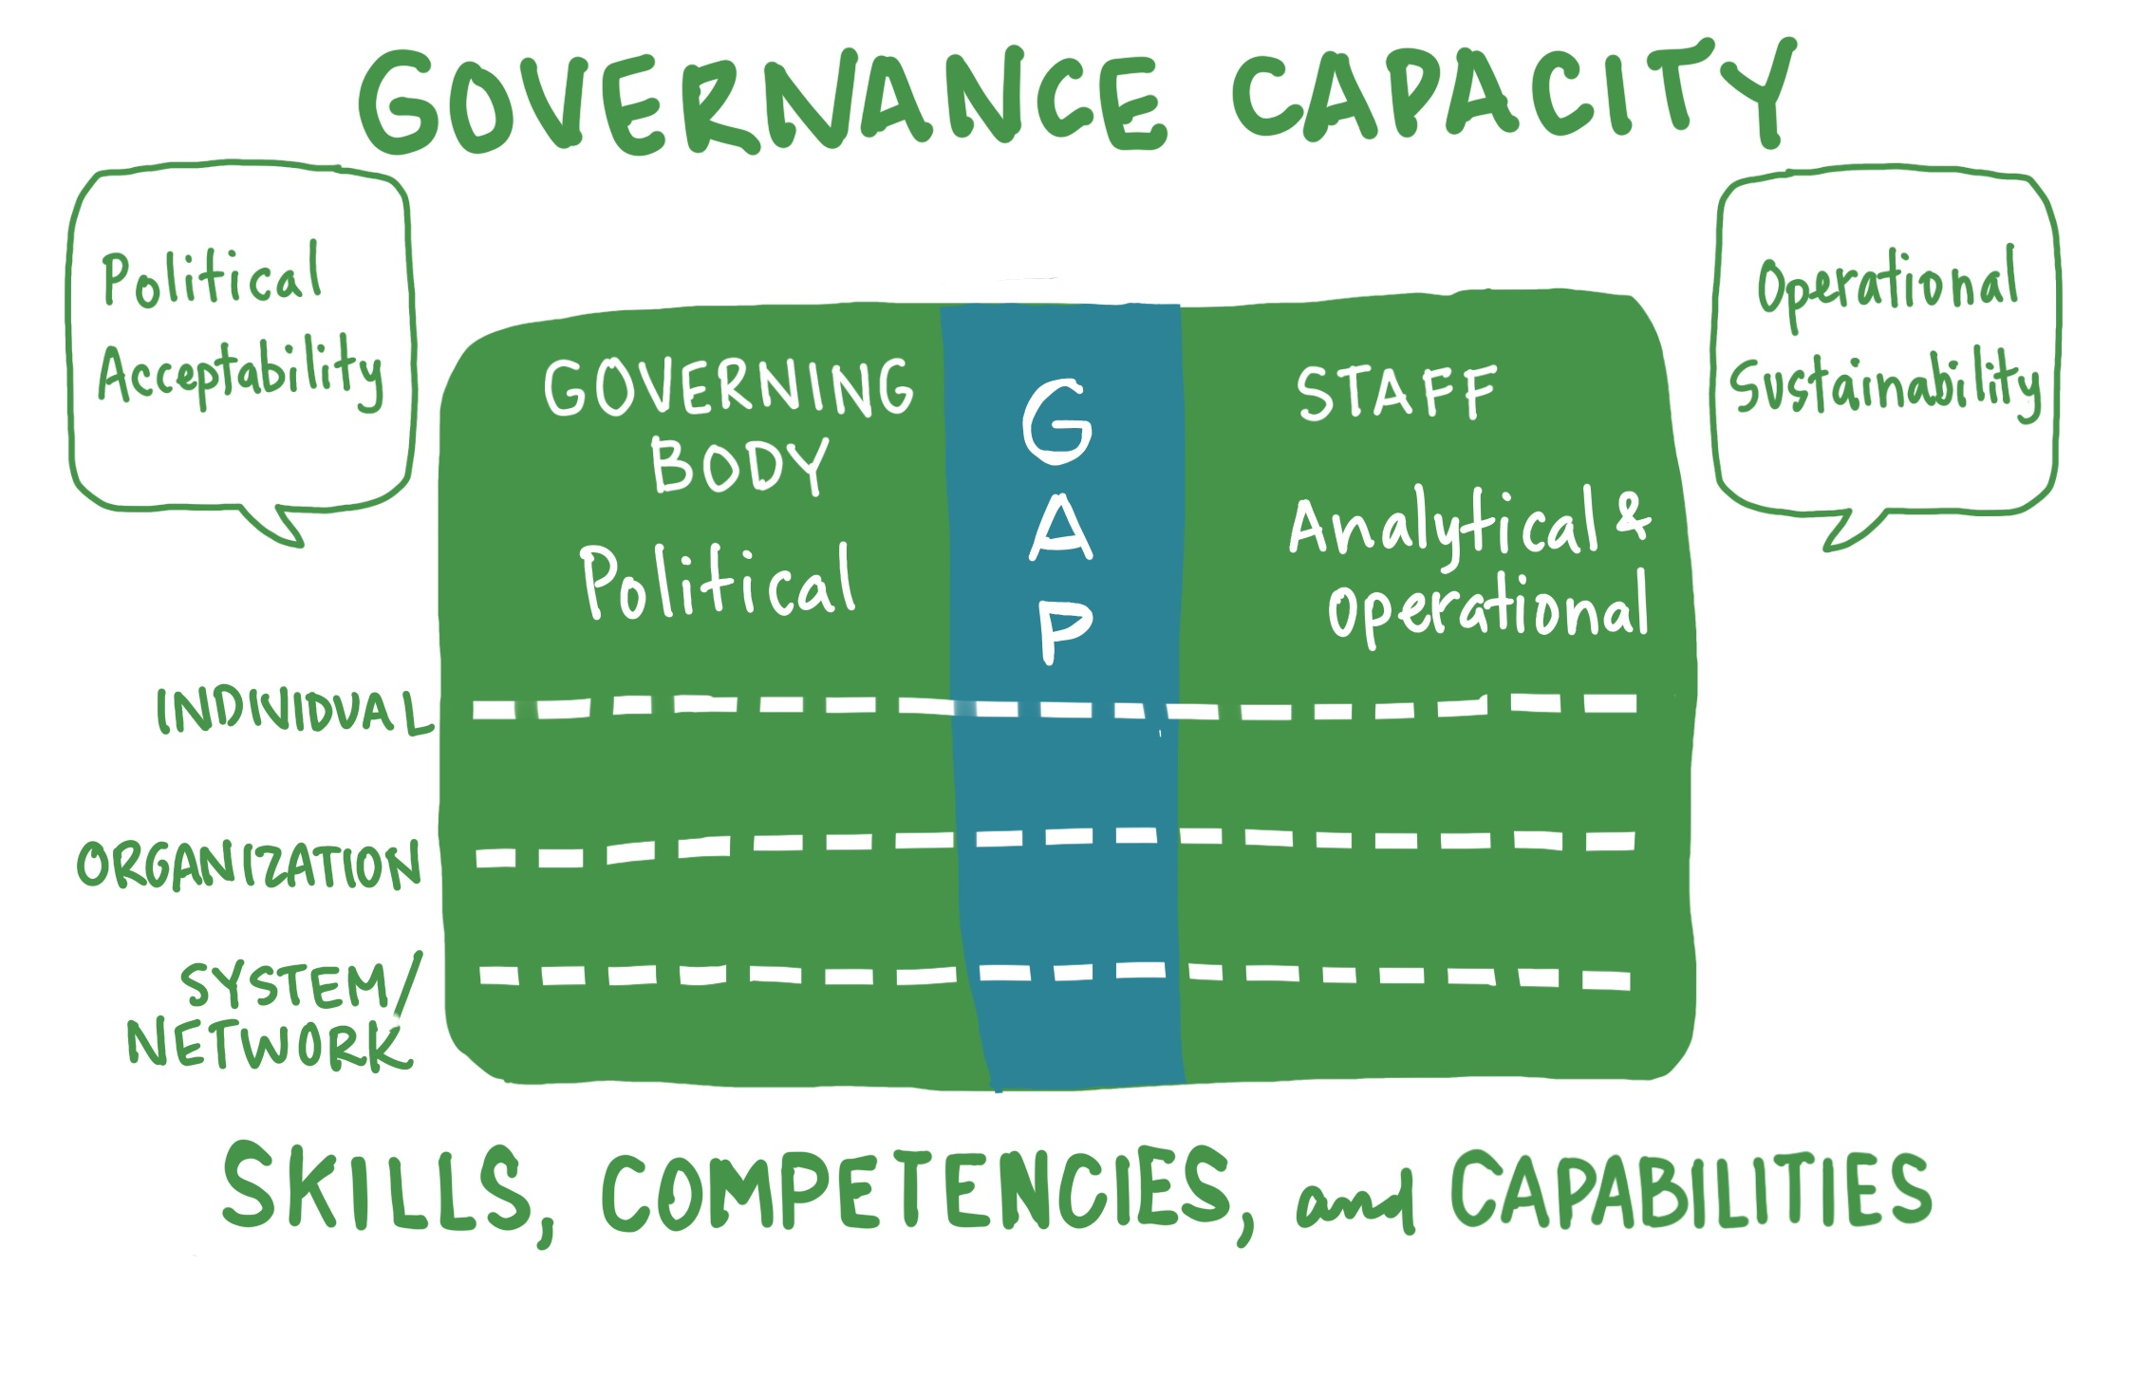
Adapted from Wu, X., M. Ramesh, and M. Howlett. “Policy Capacity: A Conceptual Framework for Understanding Policy Competencies and Capabilities.” Policy and Society. 34 (2015), 165-171.

Slide 21
Questions/Comments
Which part of the presentation will you continue to think about?
Notes:
Now, bringing the presentation to an end, I am very curious to learn from you.

Slide 22

John Nalbandian
www.goodlocalgovernment.org
nalband@ku.edu

